Slide 1
Group 2 Project
Lamp1

Slide 2
Demo Information
Access Address : http://104.215.84.239/lamp_project
Based on Azure
GitHub : https://github.com/TaehyungAlexKim/20F_Lamp1-Pizza-Store
Private Repository, if you want see this, I’ll invite you

Slide 3
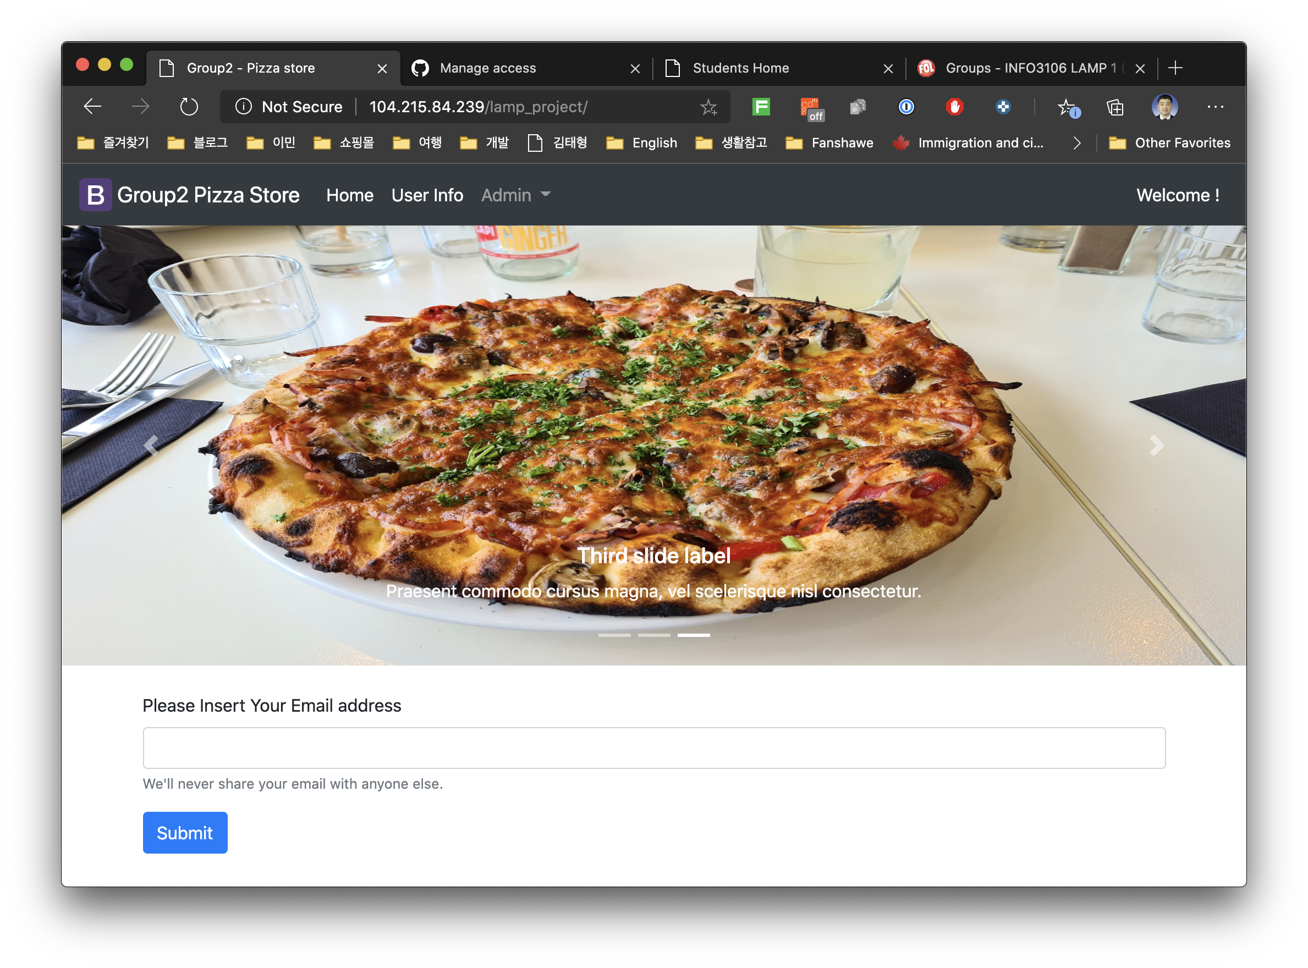
Index.php
Check the exist Email address
Check the validation
Email address

Slide 4
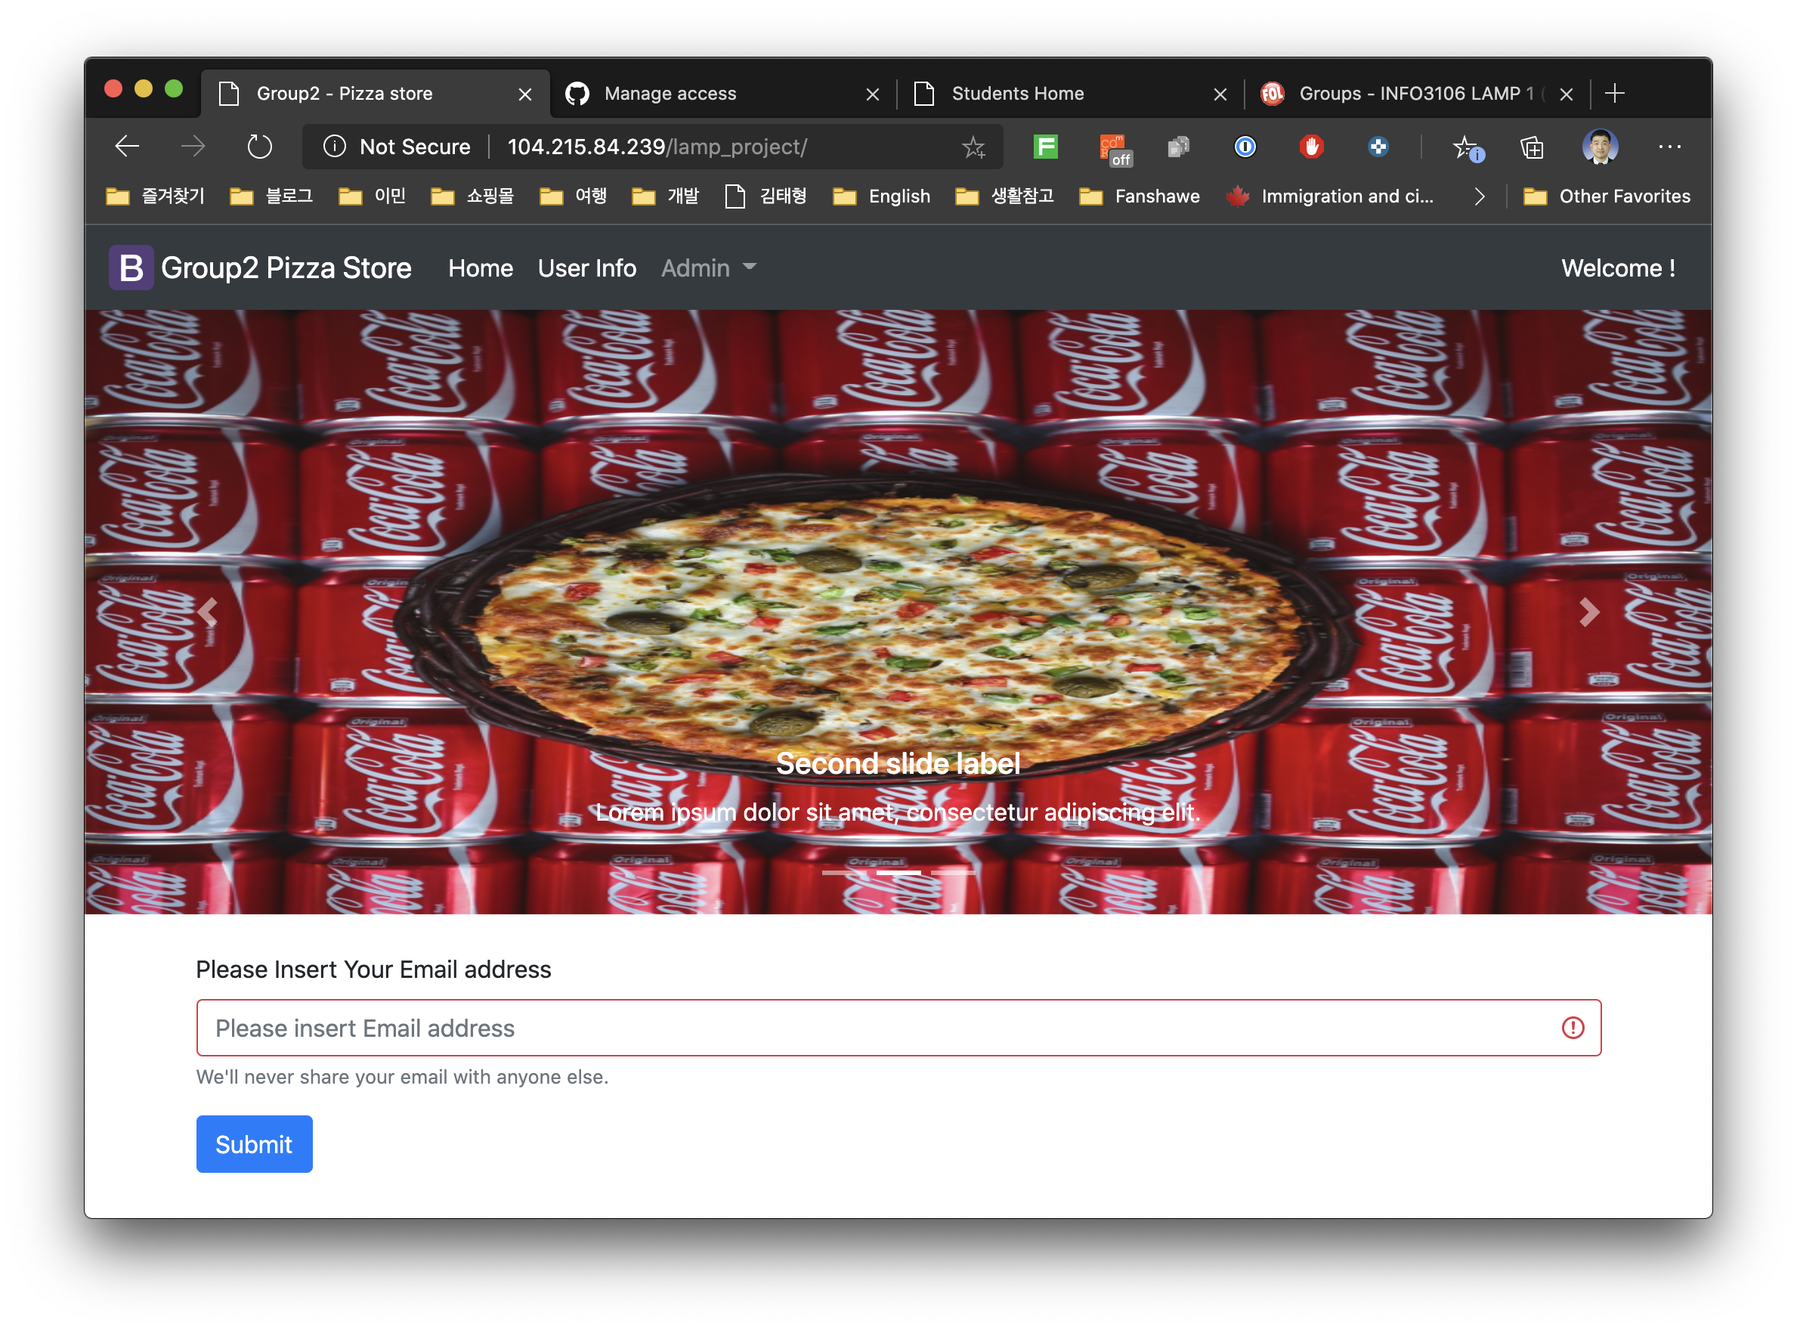
Index.php(Validation)
2 Validation Feature
Insert
Length

Slide 5
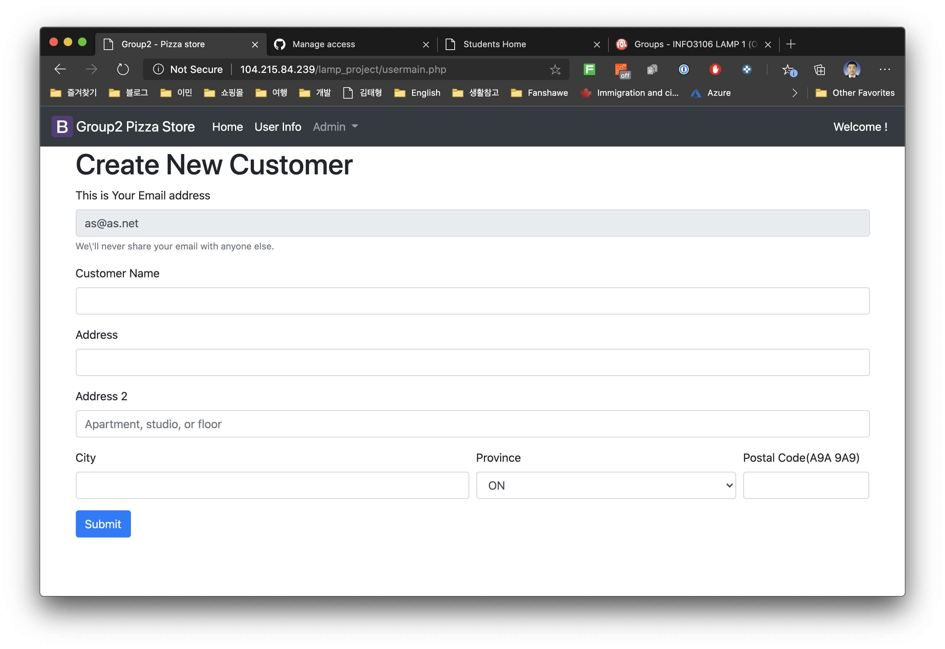
Usermain.php(if new customer)
Validation check for All form

Slide 6
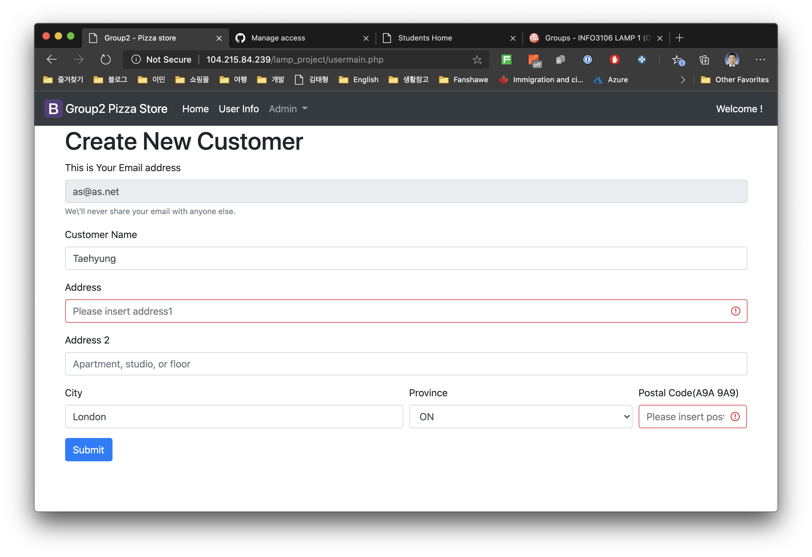
Usermain.php(Validation check)
Display function for items that have not been entered
The entered value is automatically entered

Slide 7
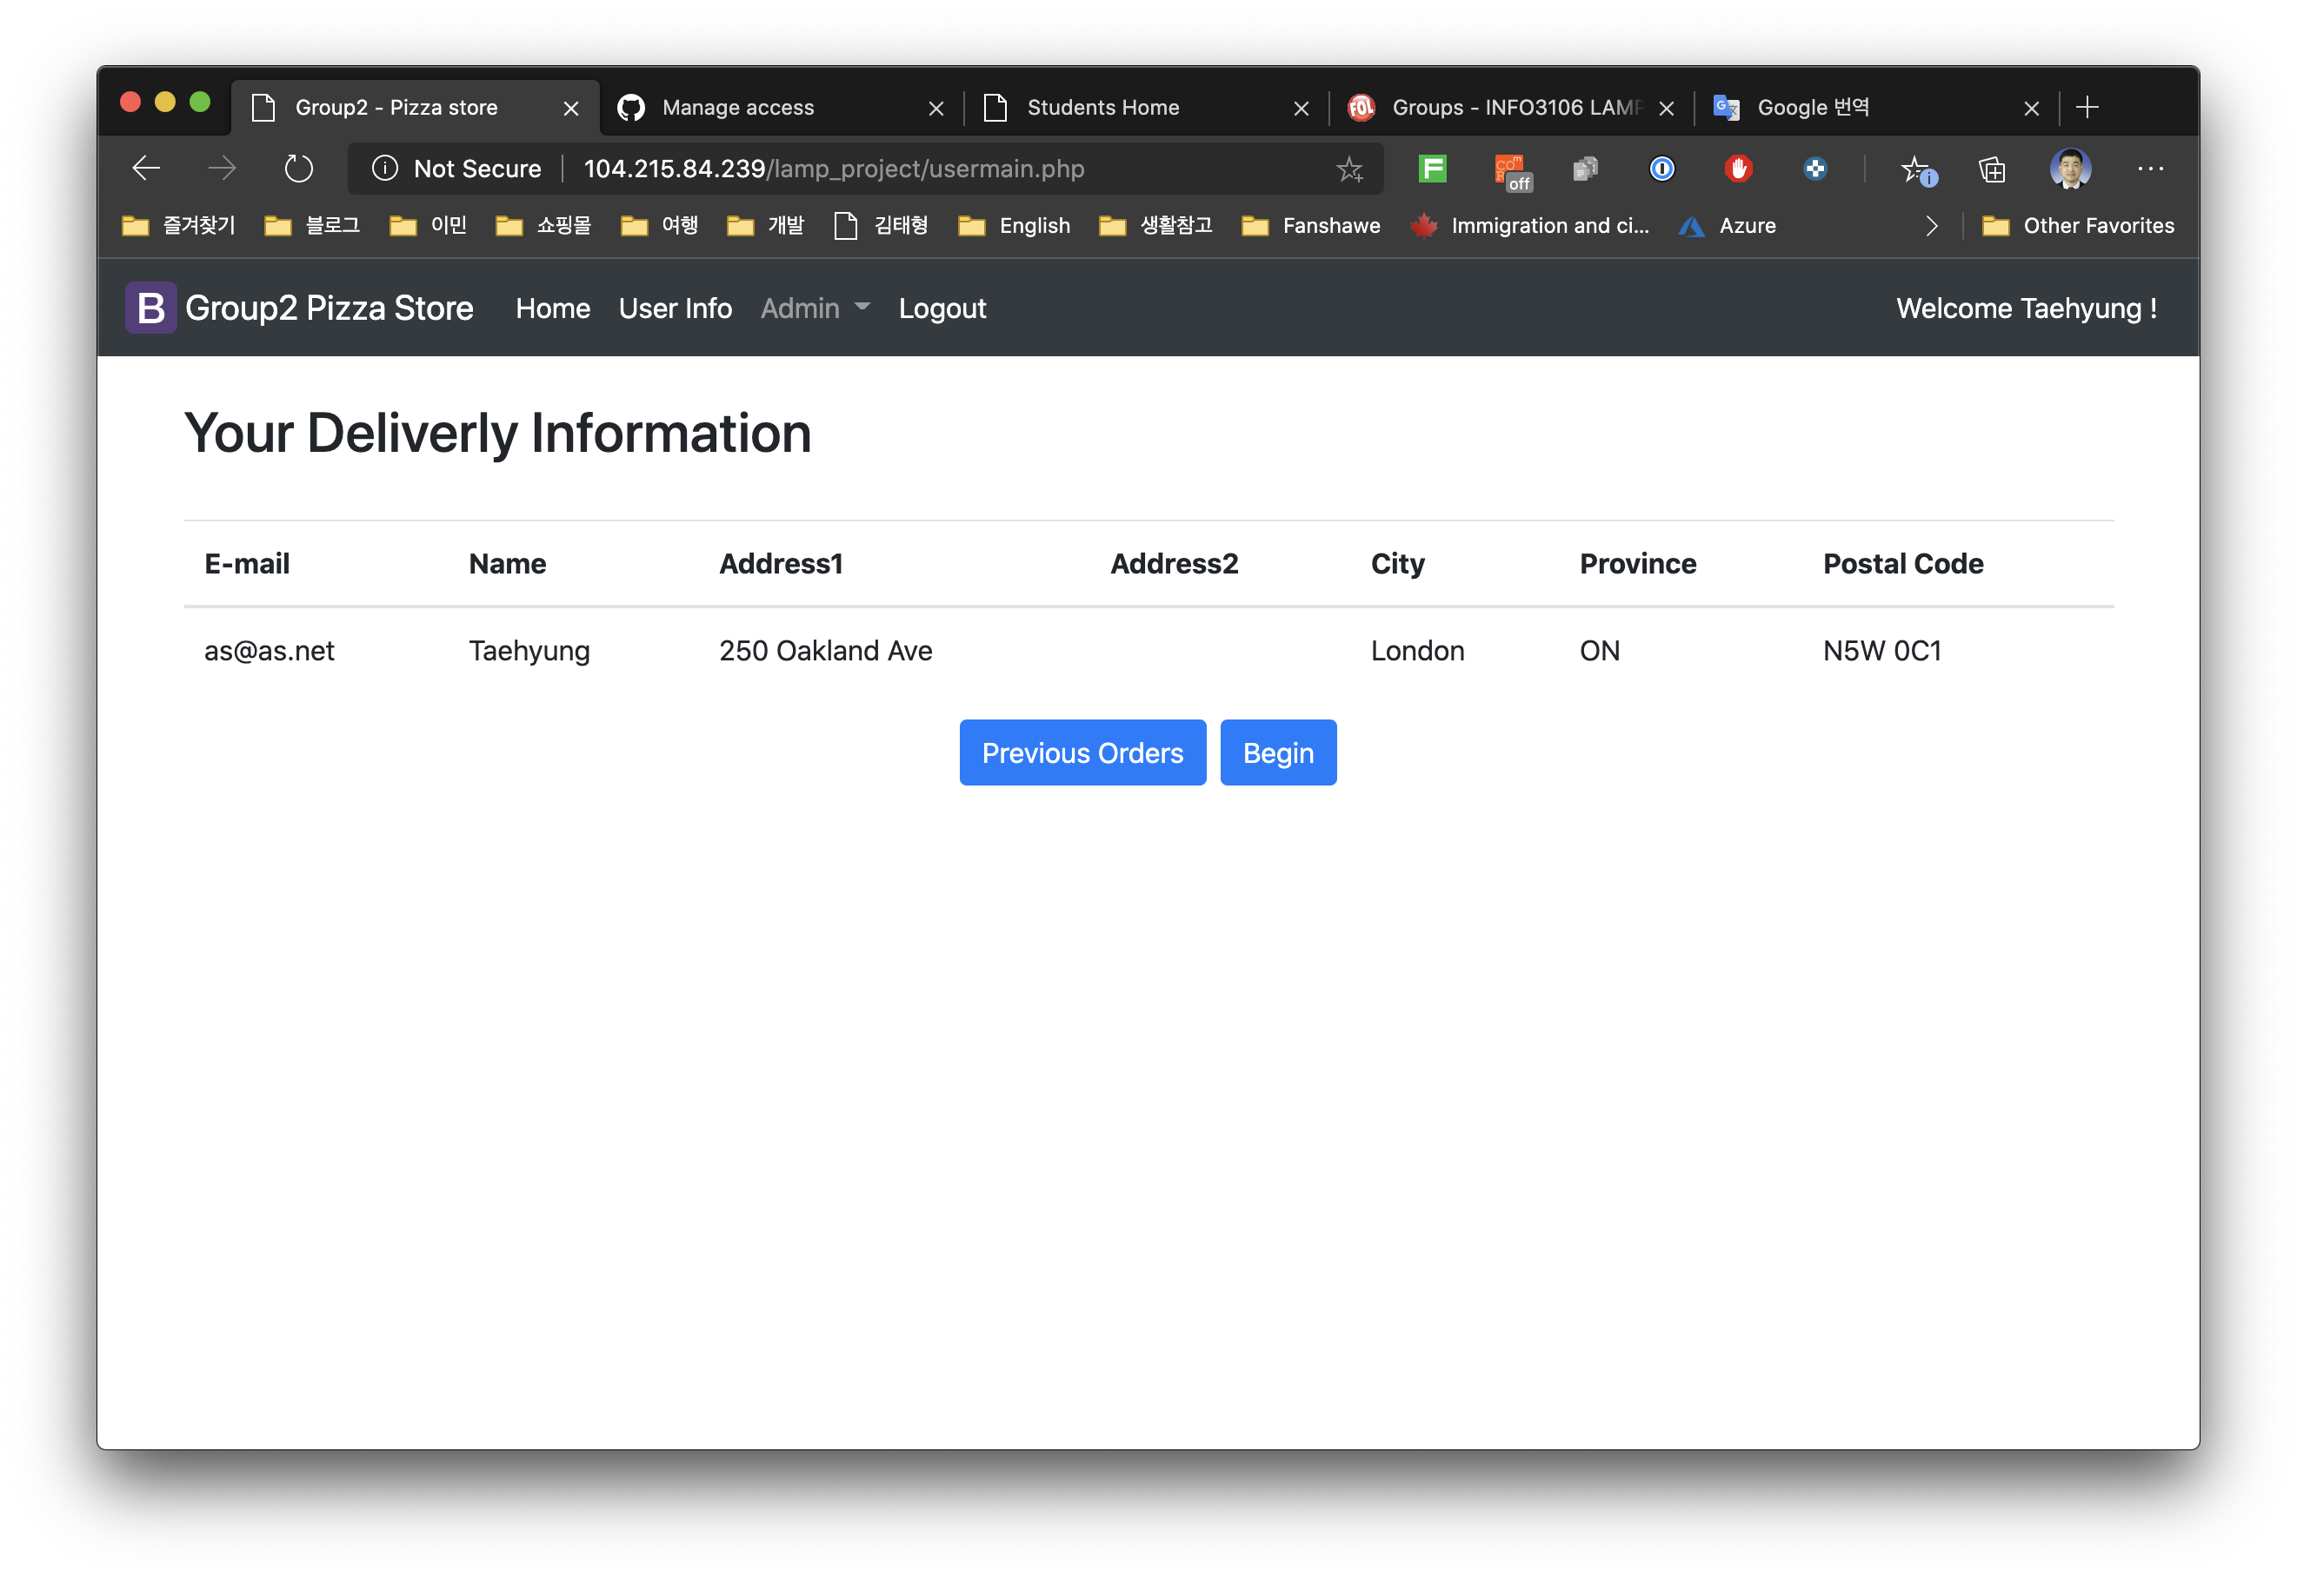
Usermain.php(existed or created customer)
Name display function
Shows a button to start an order or recall a previous order

Slide 8
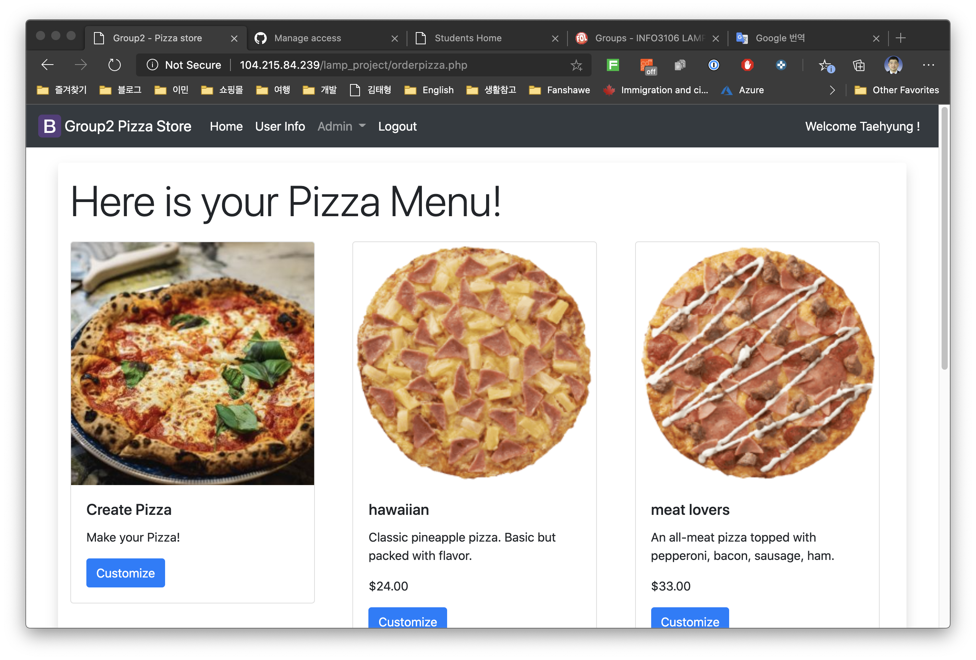
Orderpizza.php
Customers can make a new pizza or choose from the menu.

Slide 9
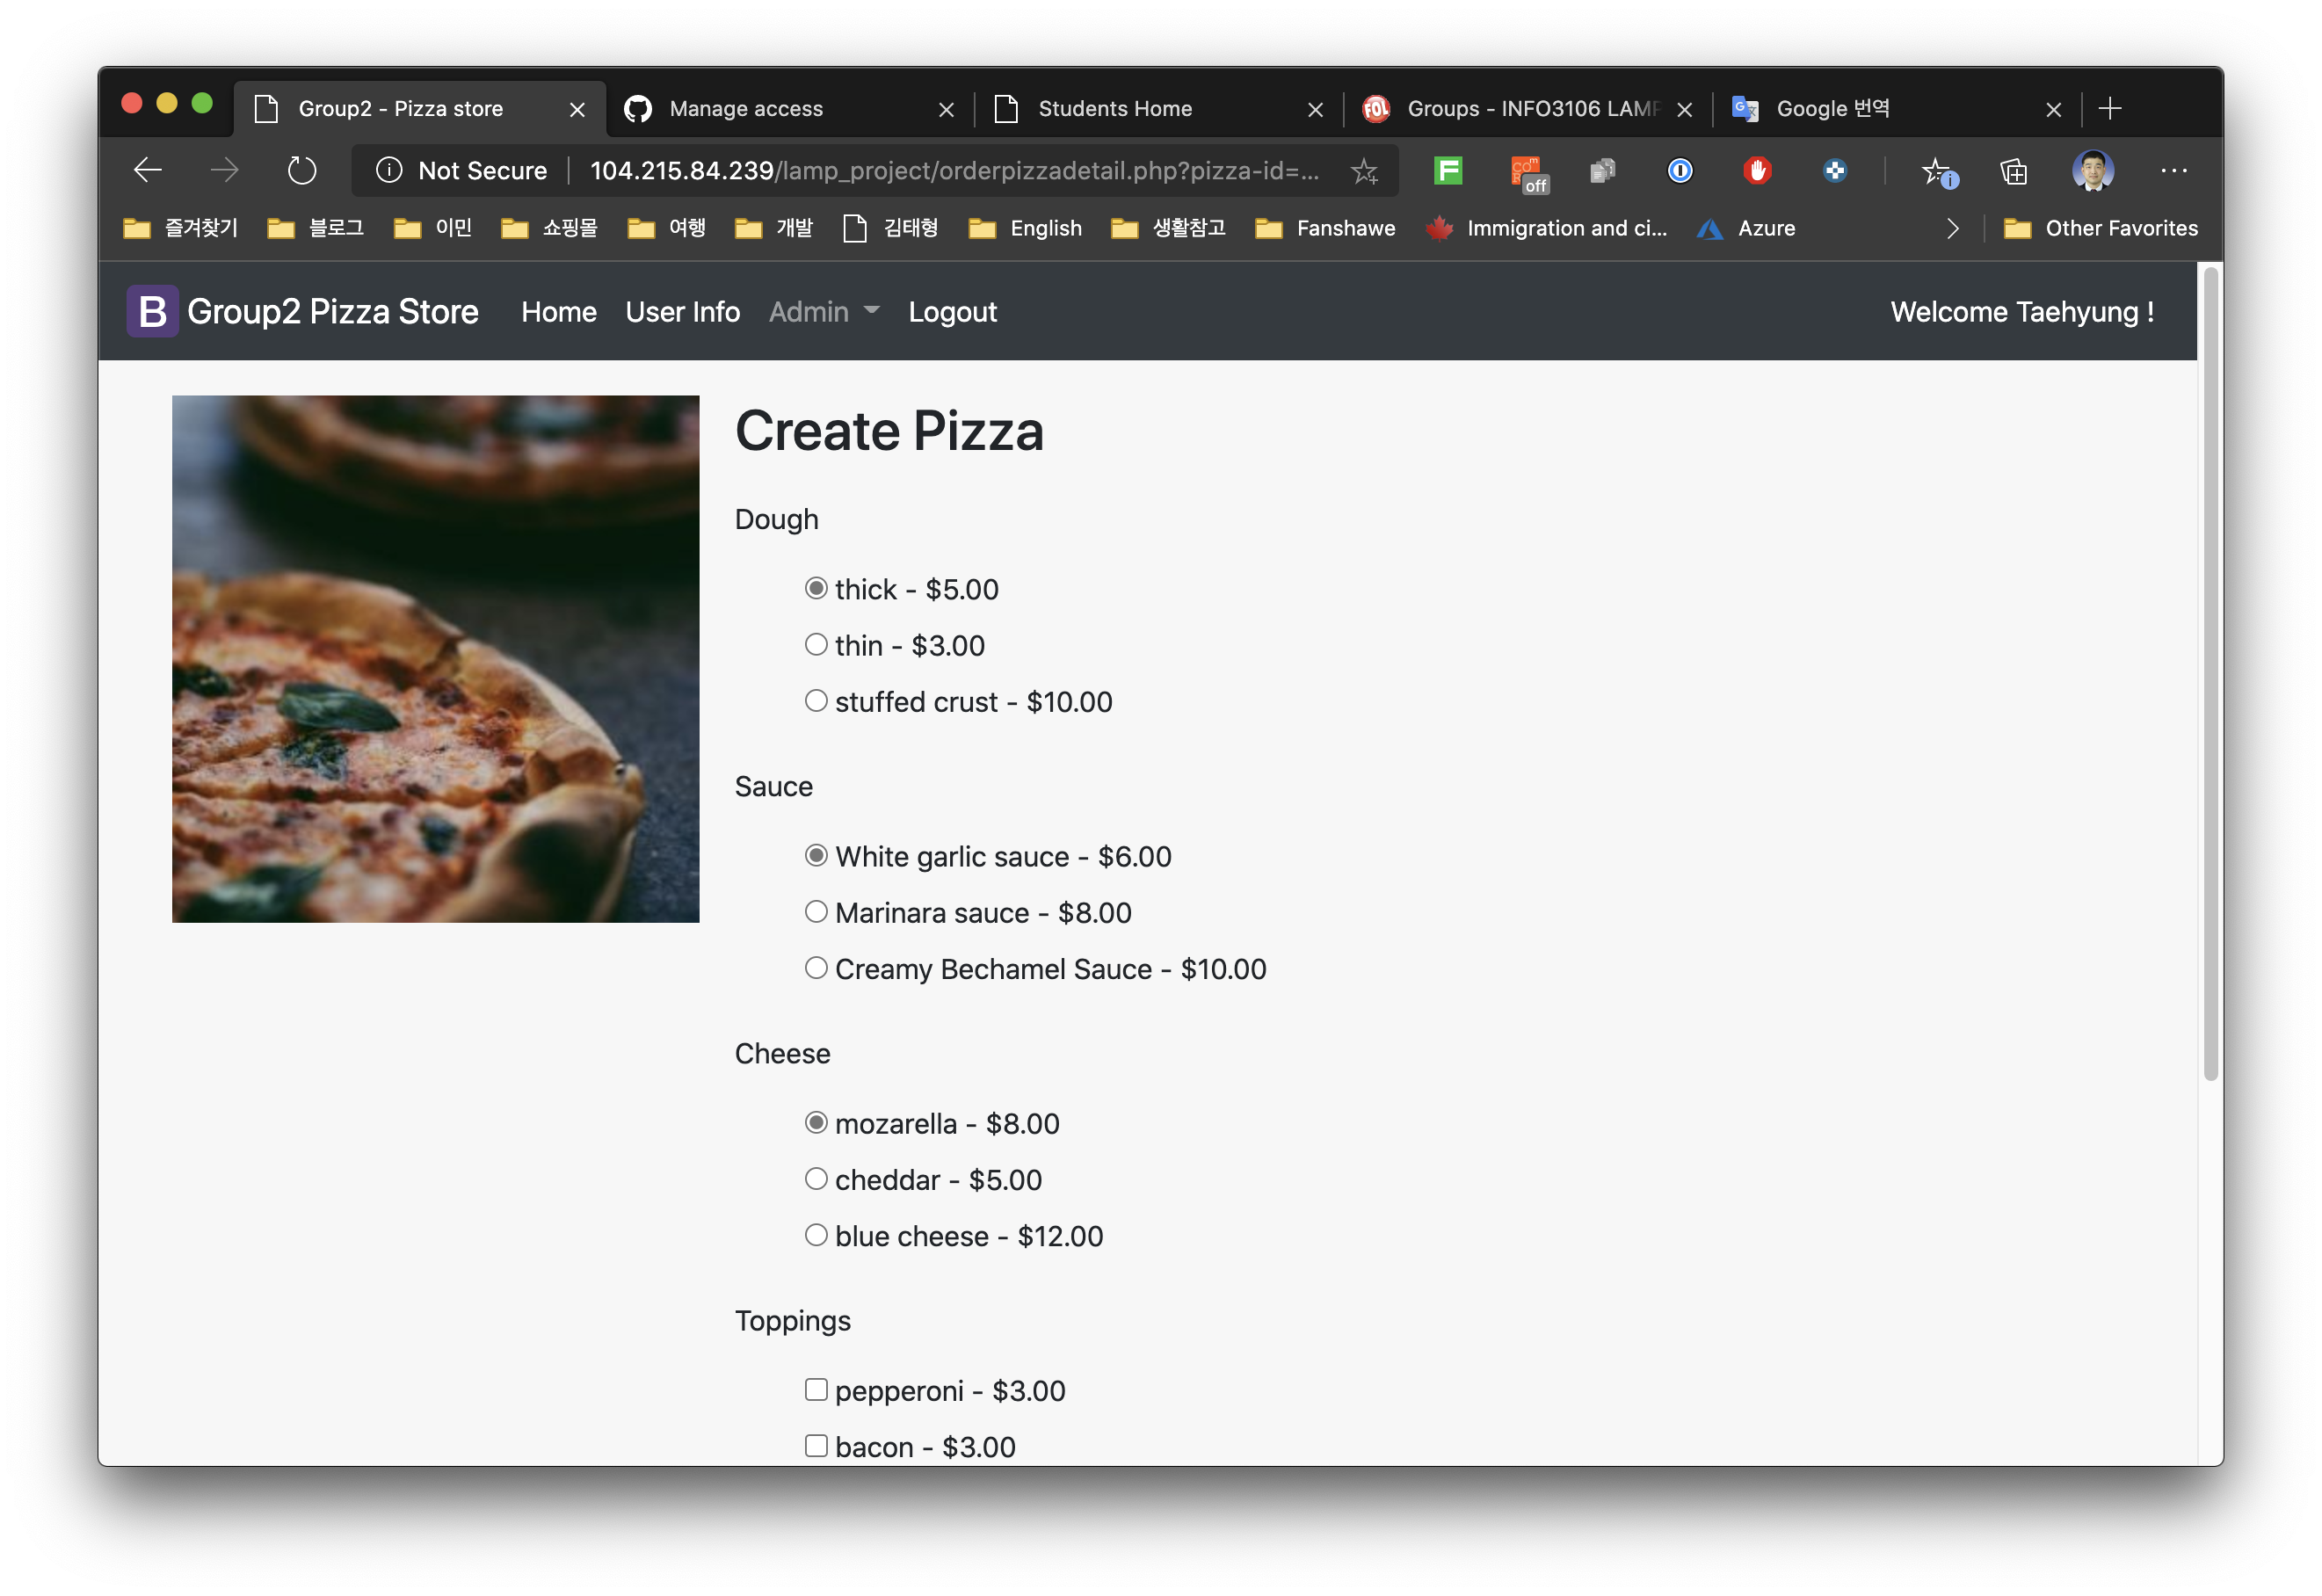
Orderpizza.php(Create Pizza)
Customers can choose dough, sauce, cheese and toppings themselves

Slide 10
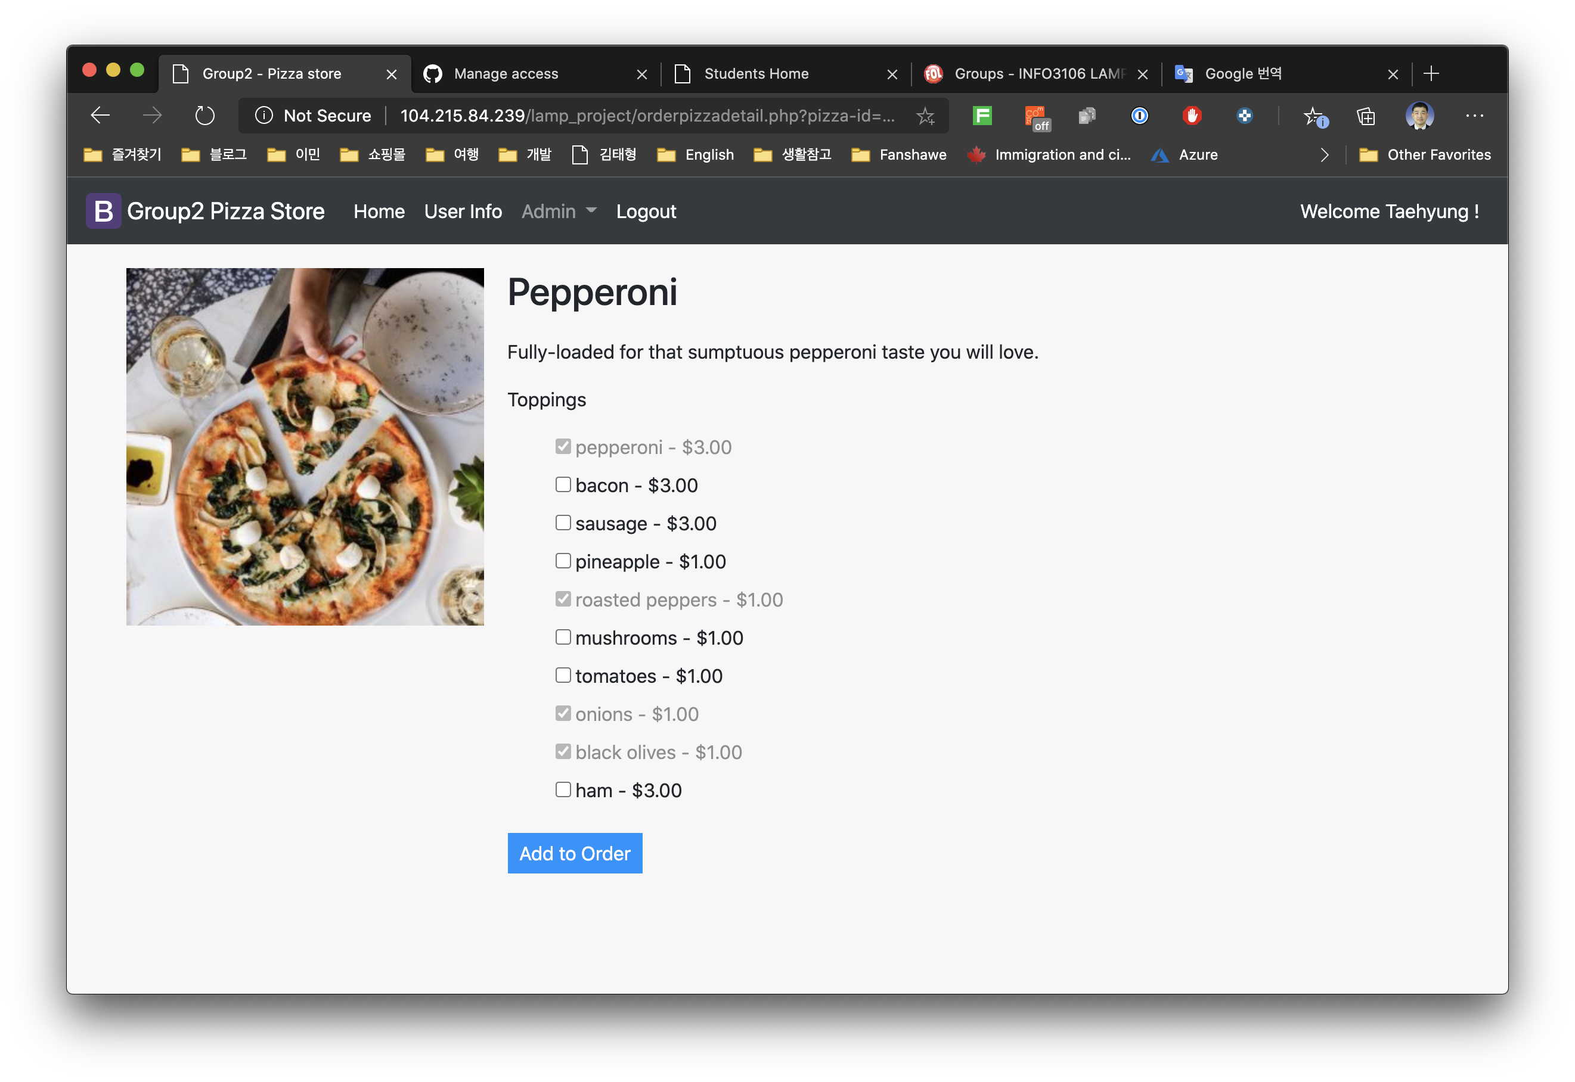
Orderpizza.php(Menu Pizza)
Customers can choose additional toppings on the pizza of their choice from the menu

Slide 11
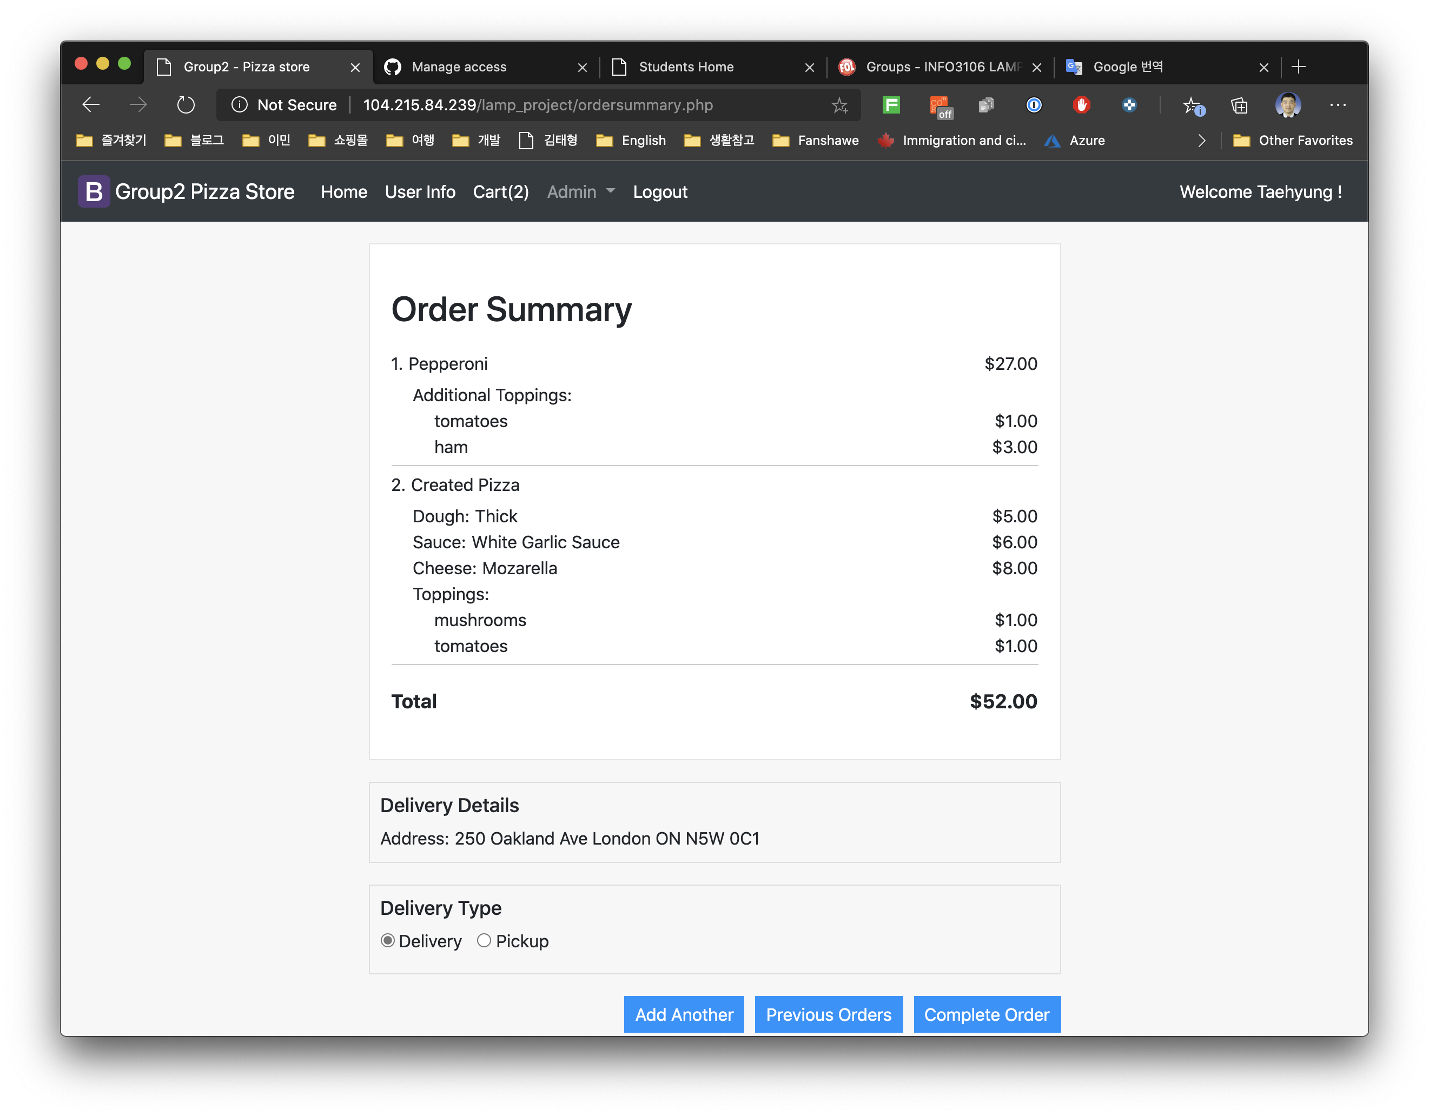
Ordersummary.php
Cart display function
Multiple pizza ordering function
Delivery address display function using customer information
Delivery method selection function

Slide 12
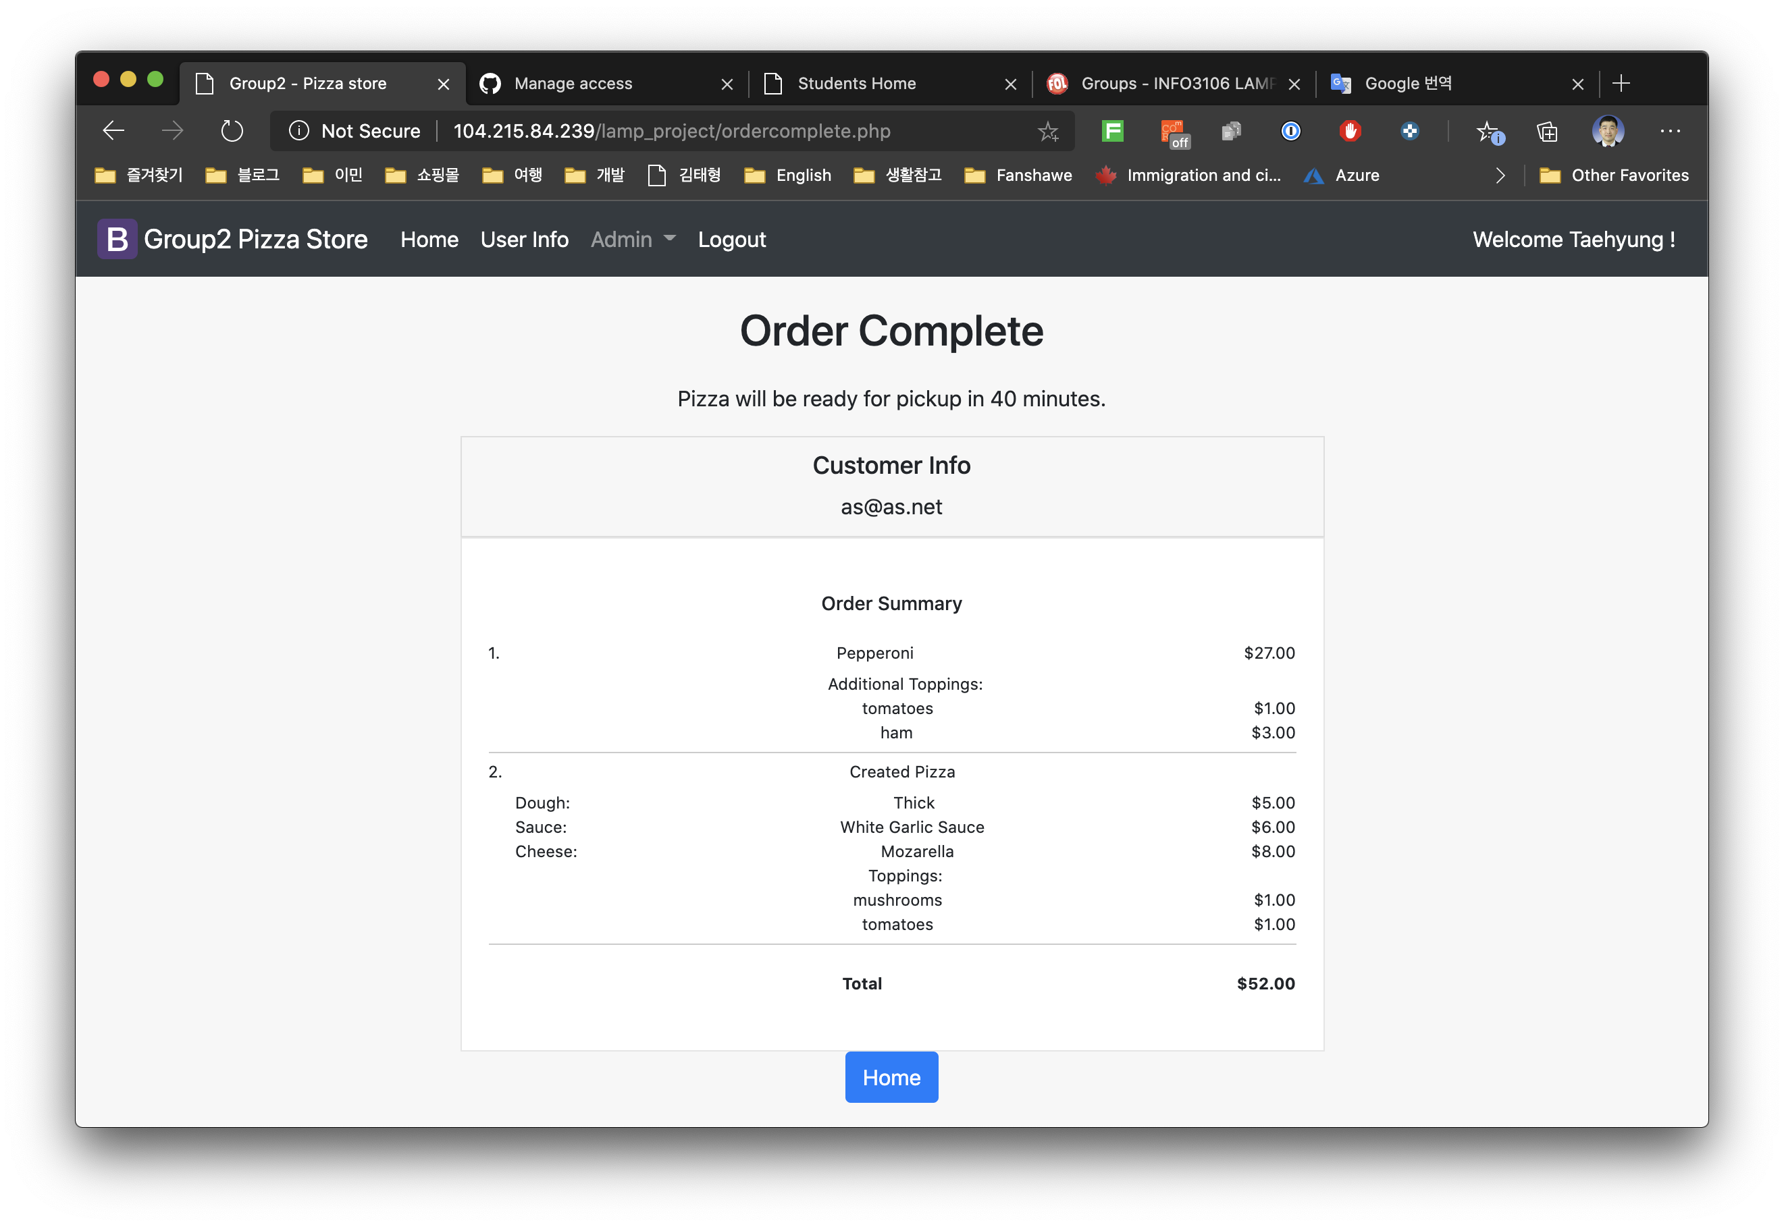
Ordercomplete.php
Display messages according to delivery method
Display order results

Slide 13
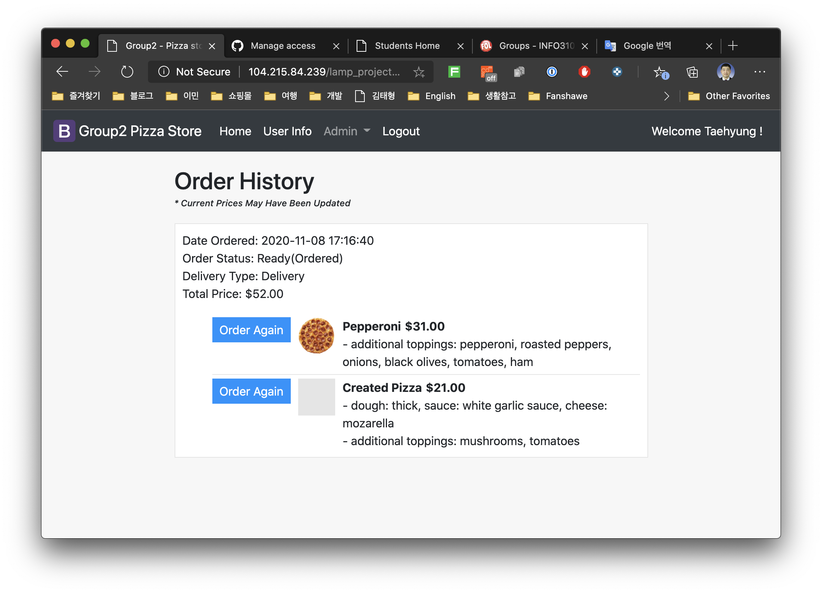
Previousorders.php
Customers can view previous orders, check order status and place reorders.

Slide 14
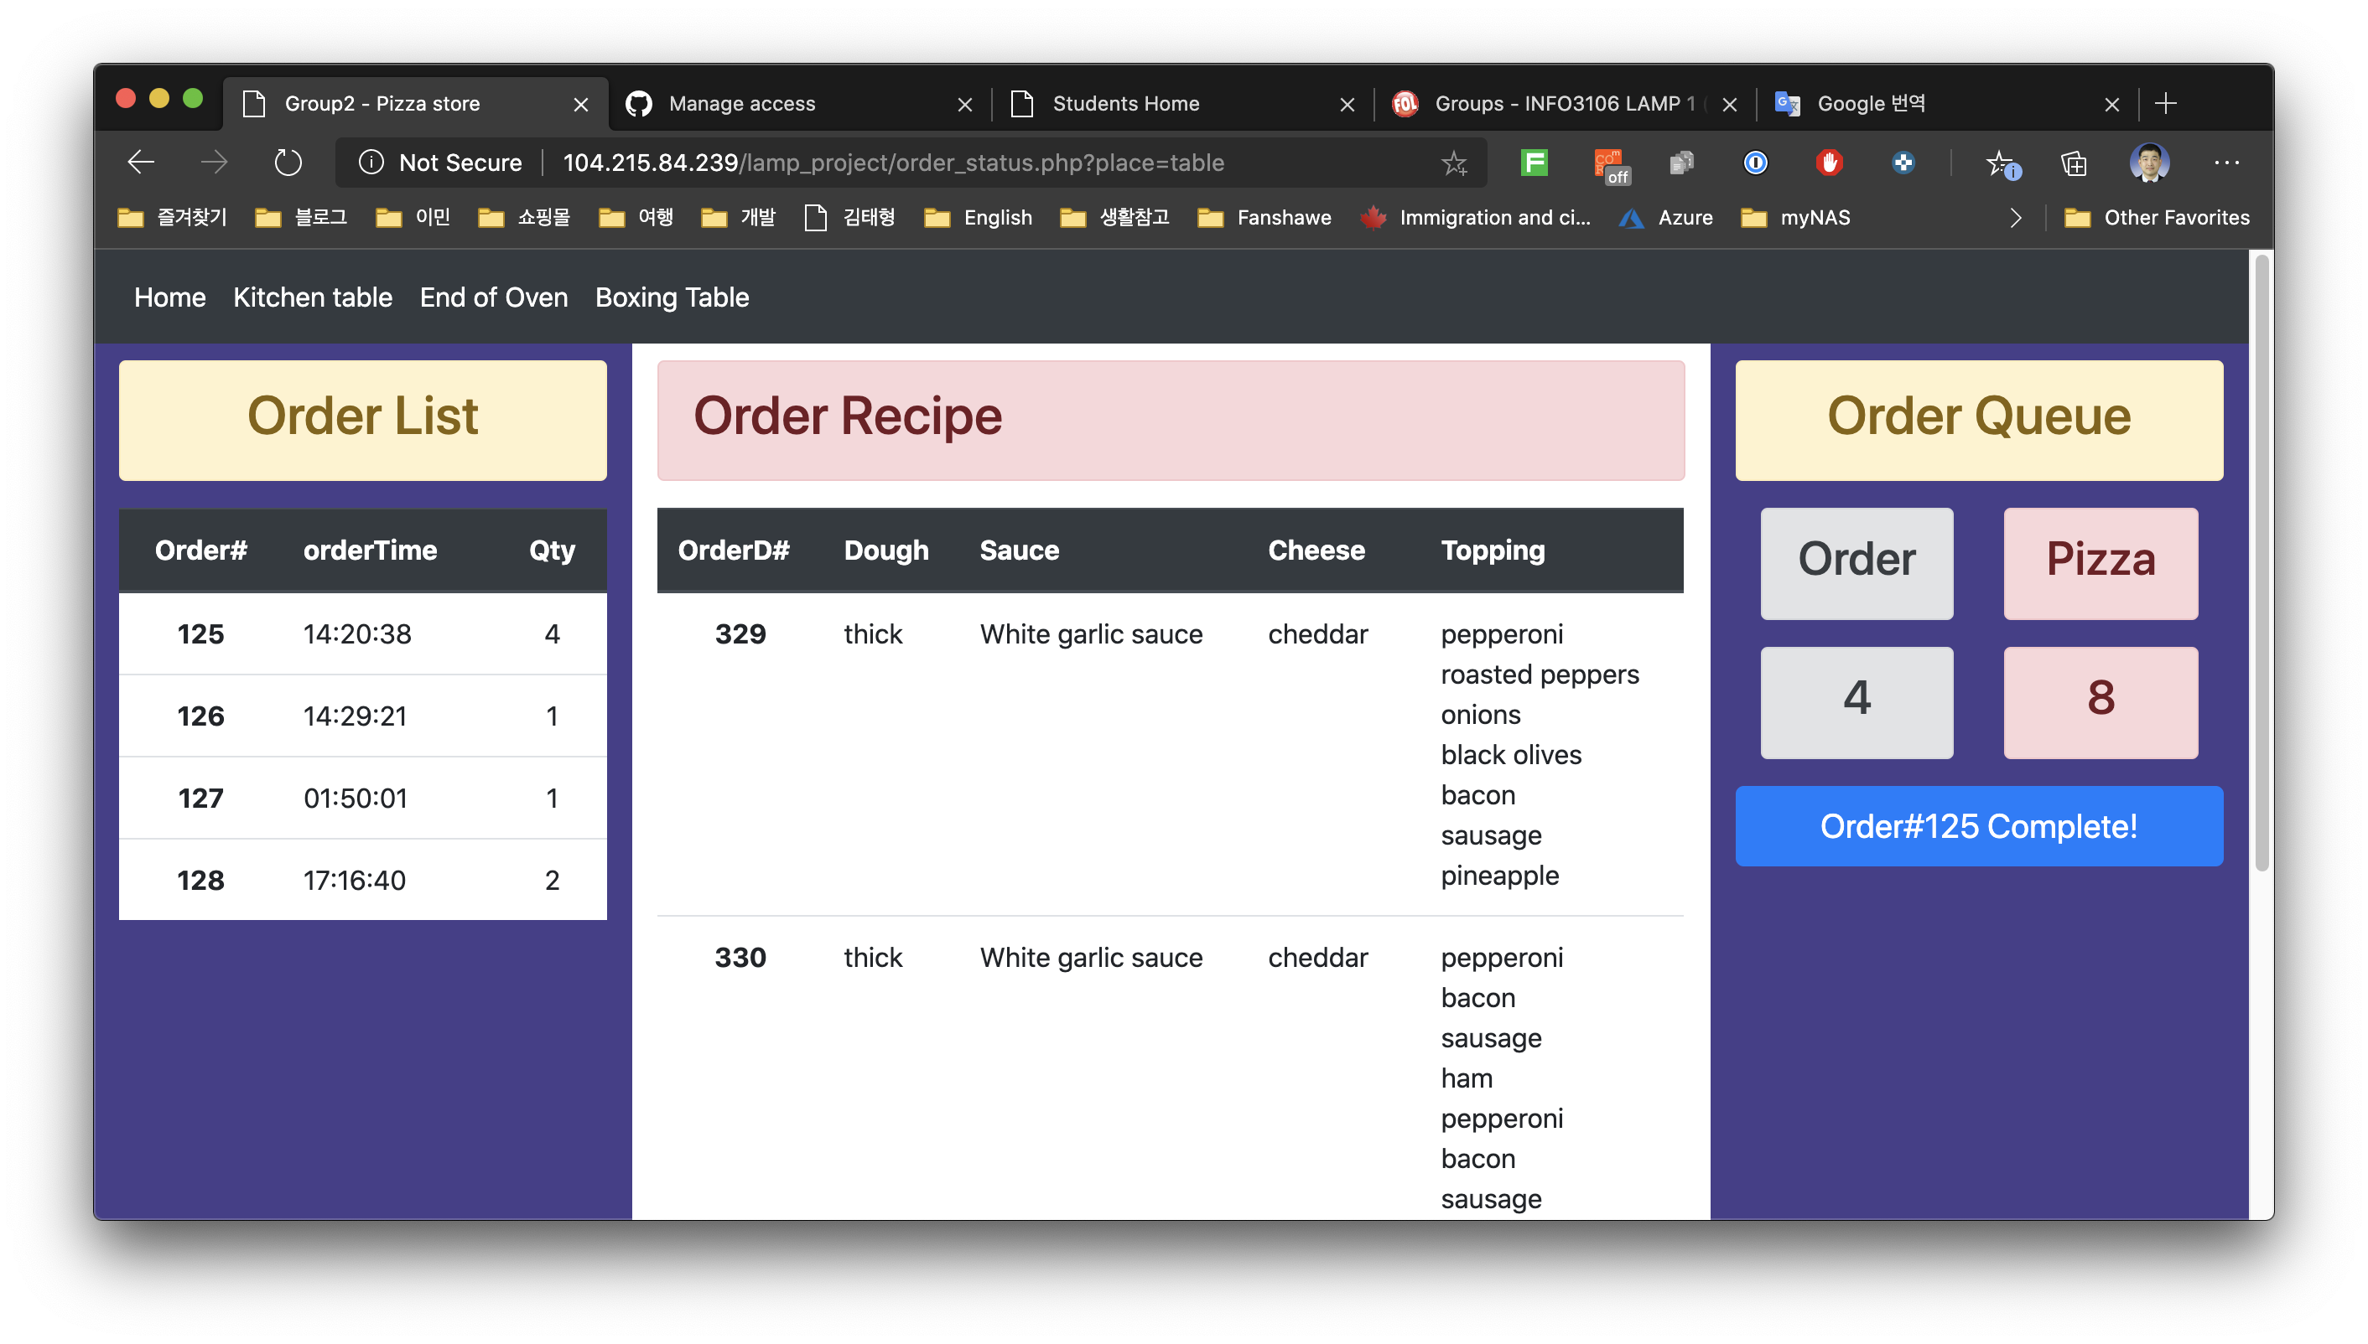
Admin(status-prep table)

Slide 15
Admin(status-prep table)
Display a list of pizza orders that the employee must make.

Slide 16
Admin(status-prep table)
Display the pizza recipe.

Slide 17
Admin(status-prep table)
Display the Order Queue
When employee click the button, the made pizza is put into the oven, and the recipe for the next pending order is displayed.

Slide 18
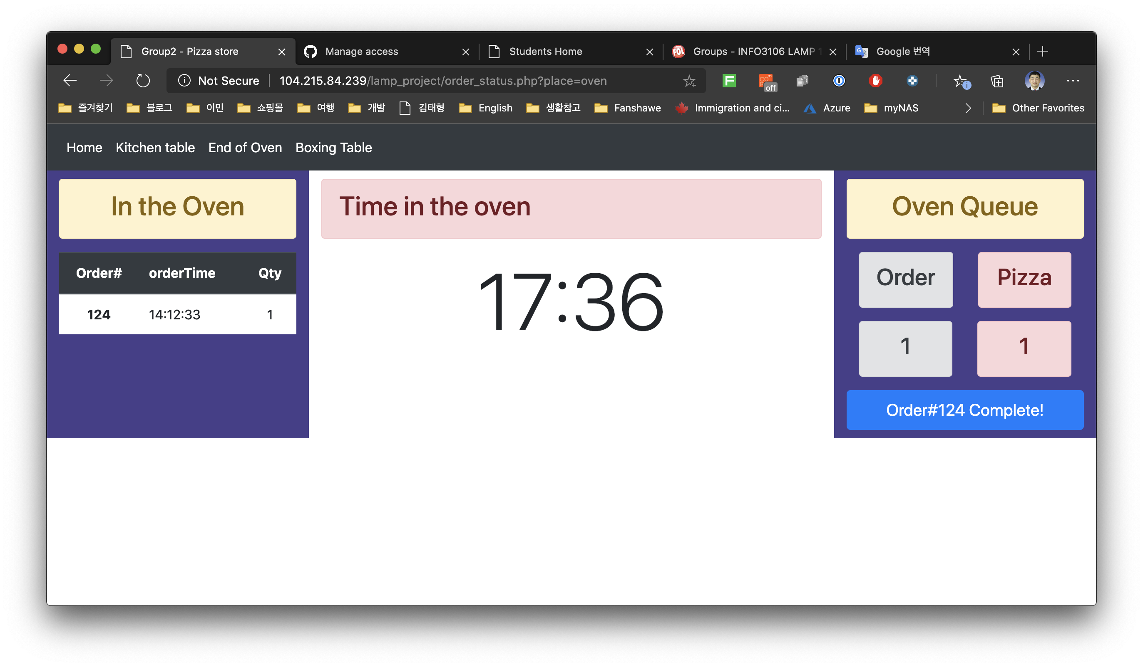
Admin(status-Oven)

Slide 19
Admin(status-Oven)
Indicate the order numbers of the pizzas in the oven.

Slide 20
Admin(status-Oven)
Displays the time of the pizza that has been in the oven the longest.

Slide 21
Admin(status-Oven)
Indicate the number of orders and pizzas in the oven.
At the click of a button, the pizza in the oven is taken out and transferred to a table for box packaging.

Slide 22
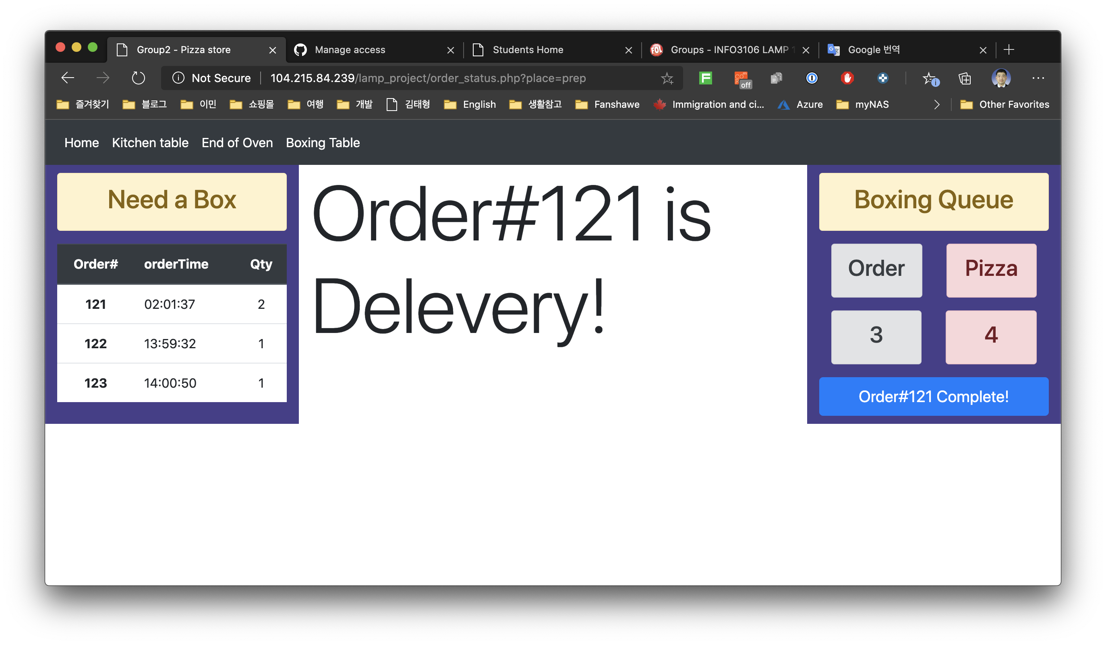
Admin(status-boxing)

Slide 23
Admin(status-boxing)
Display a list of pizza orders that need to be boxed.

Slide 24
Admin(status-boxing)
Display a type of delivery

Slide 25
Admin(status-boxing)
Indicate the number of pizzas and orders that need to be boxed.

Slide 26
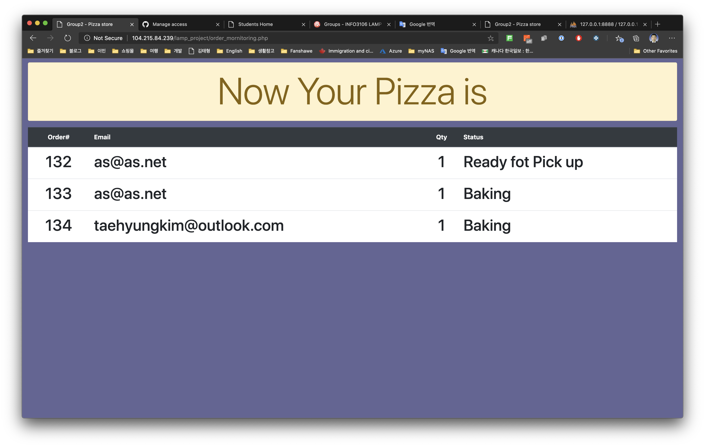
Admin(monitoring)

Slide 27
Admin(monitoring)
It displays order progress to customers who visit the store for pickup.

